Slide 1
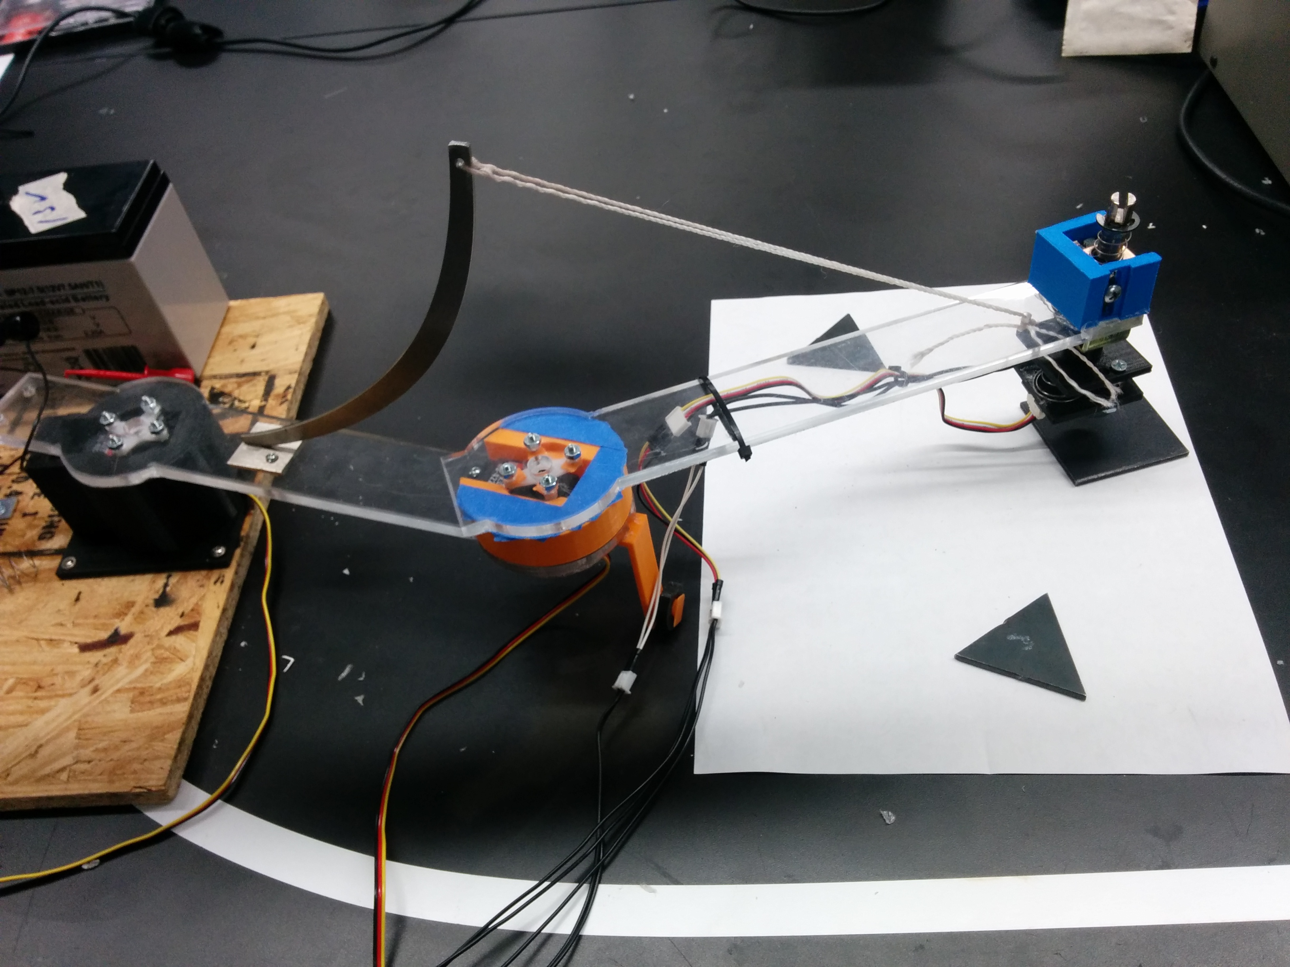
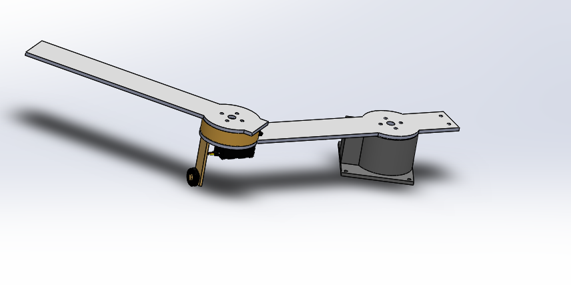
UR2 PNP Term Project
Torsten Schill

Slide 2
Structure
Requirements
Research
Mechanical Design
Software Design
Budget
Summary

Slide 3
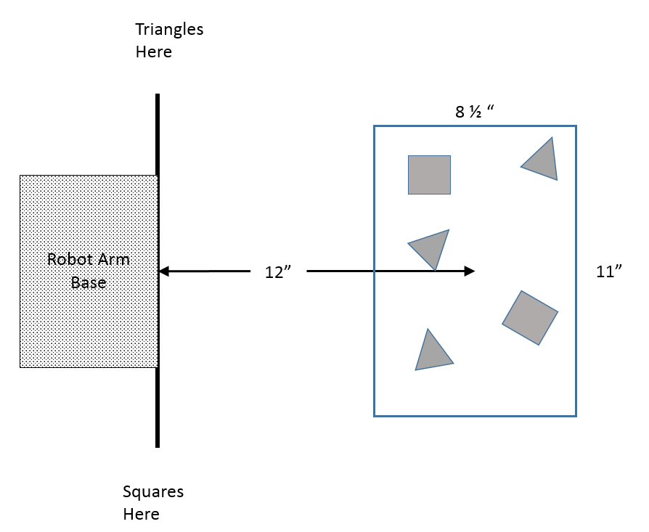
Project Requirements
fully automated robotic system that performs a pick-and-place operation.
identifying triangular or square that are randomly placed on a white surface centered 12 inches away from the base of the robot
picking the parts, and moving them to two different stacks
freeze the operation immediately when any yellow color blob is detected

Slide 4
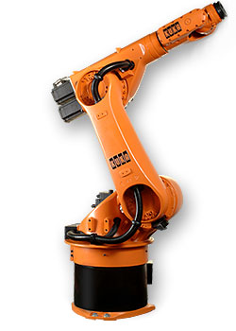
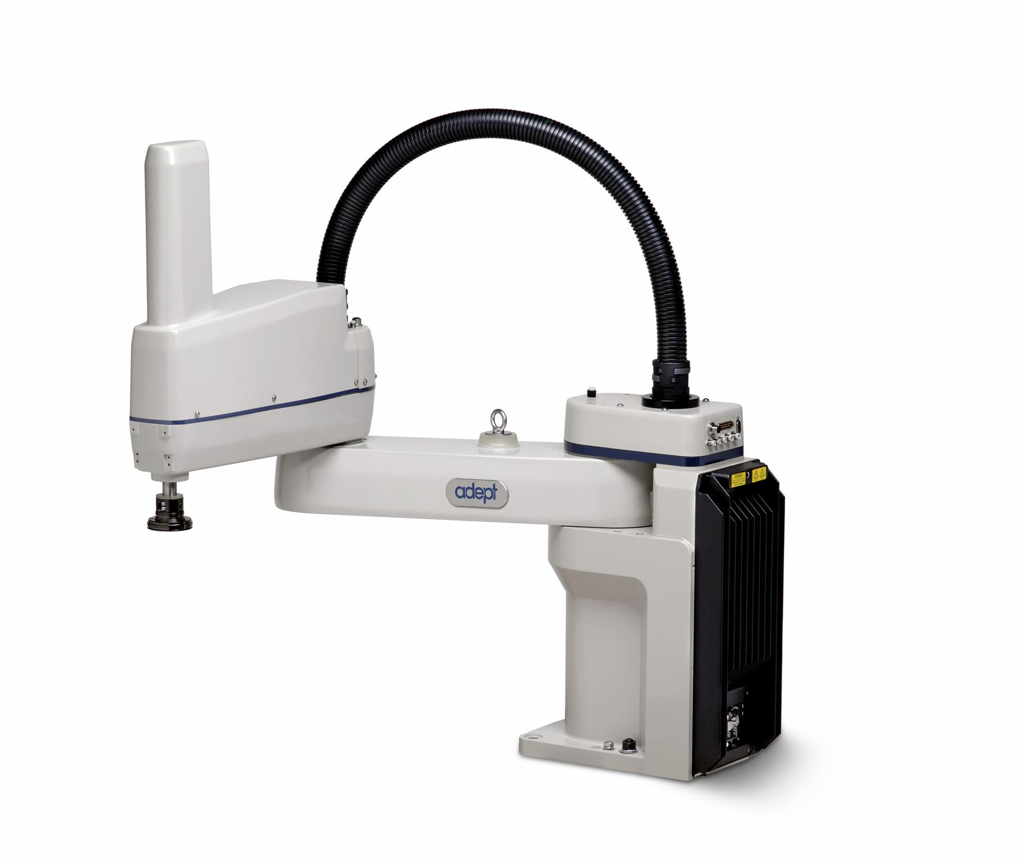
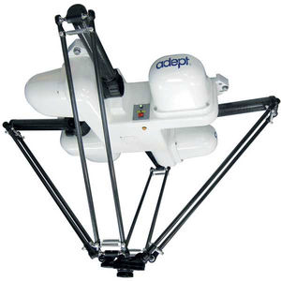
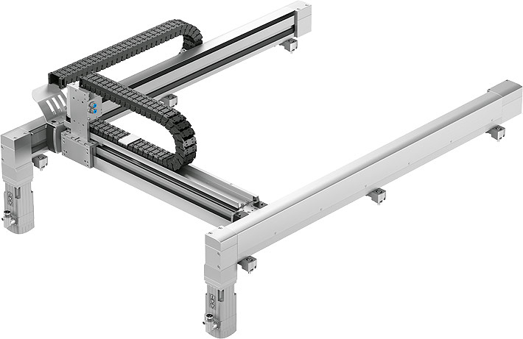
Research

Slide 5
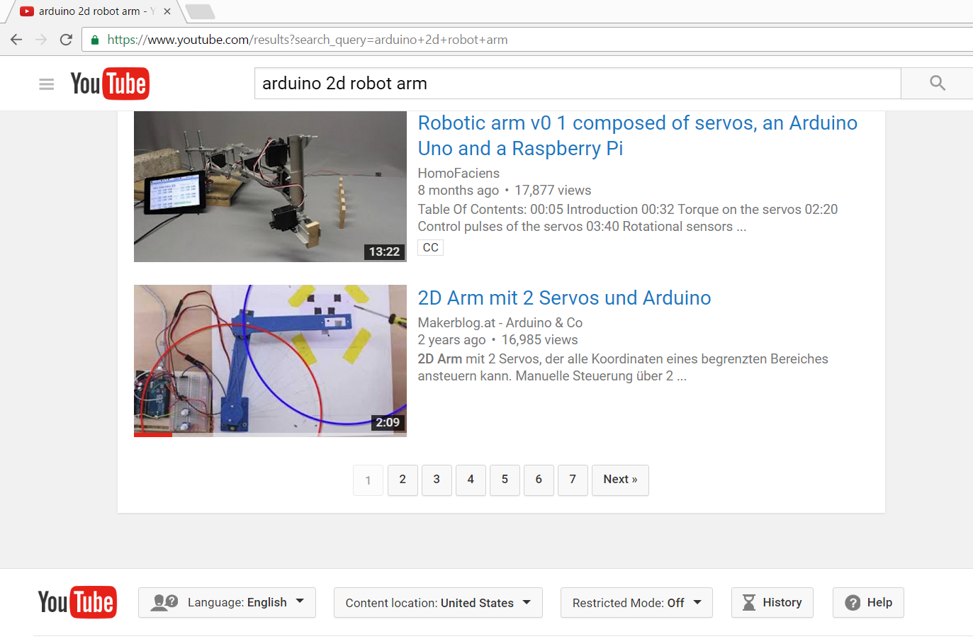
Research

Slide 6
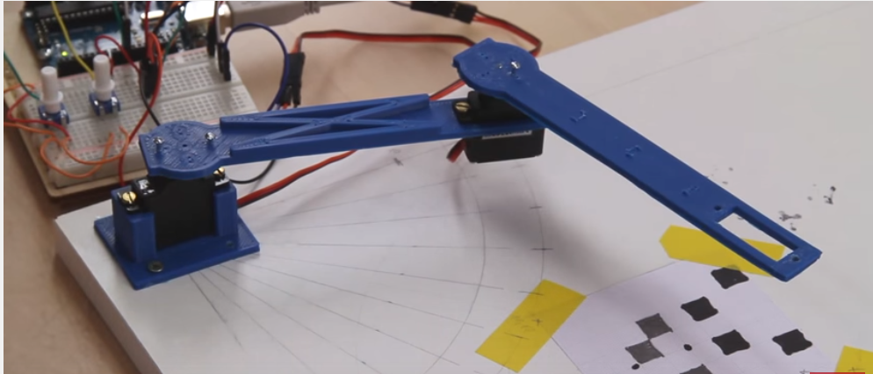
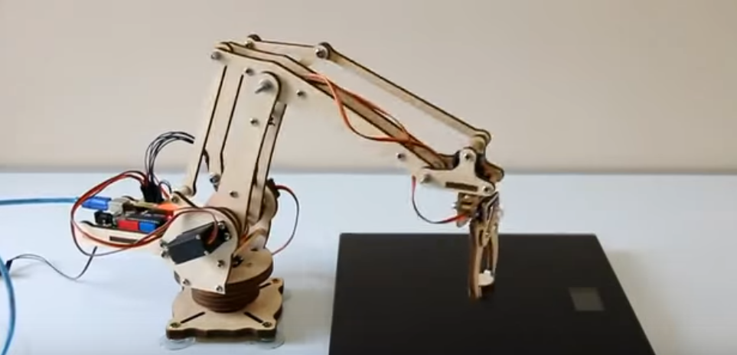
Designs considered
+ Only 2 Motors
+ Easier Mechanics to build
+ Cheaper
+ Flexibel

Slide 7
Design Scara Phase Development Model
Requirements
Design
Implementation
Validation
Deployment
Requirements Midterm
Design Midterm
Implementation Midterm
Validation Midterm
Deployment Midterm

Slide 8
Mechanical Design
Requirements
Design
Implementation
Validation
Deployment
Requirements Midterm
Design Midterm
Implementation Midterm
Validation Midterm
Deployment Midterm

Slide 9
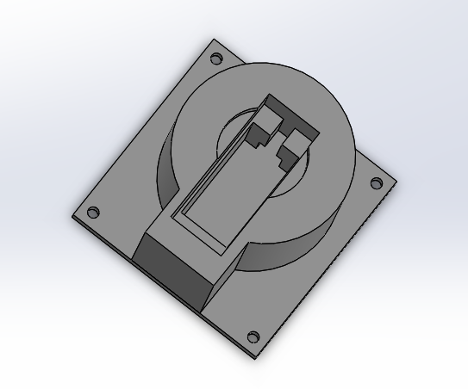
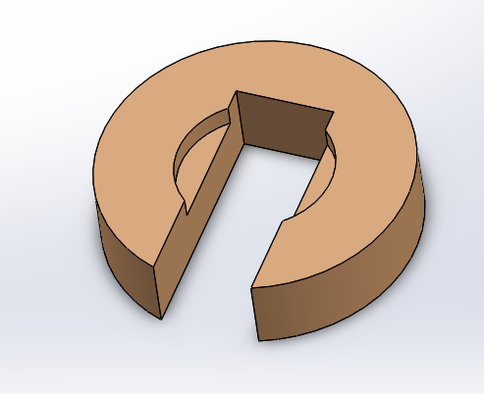
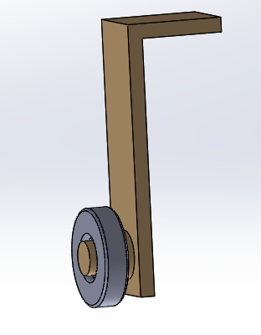
Mechanical Design

Slide 10
Mechanical Design
Requirements
Design
Implementation
Validation
Deployment
Requirements Midterm
Design Midterm
Implementation Midterm
Validation Midterm
Deployment Midterm

Slide 11
Mechanical Design

Slide 12
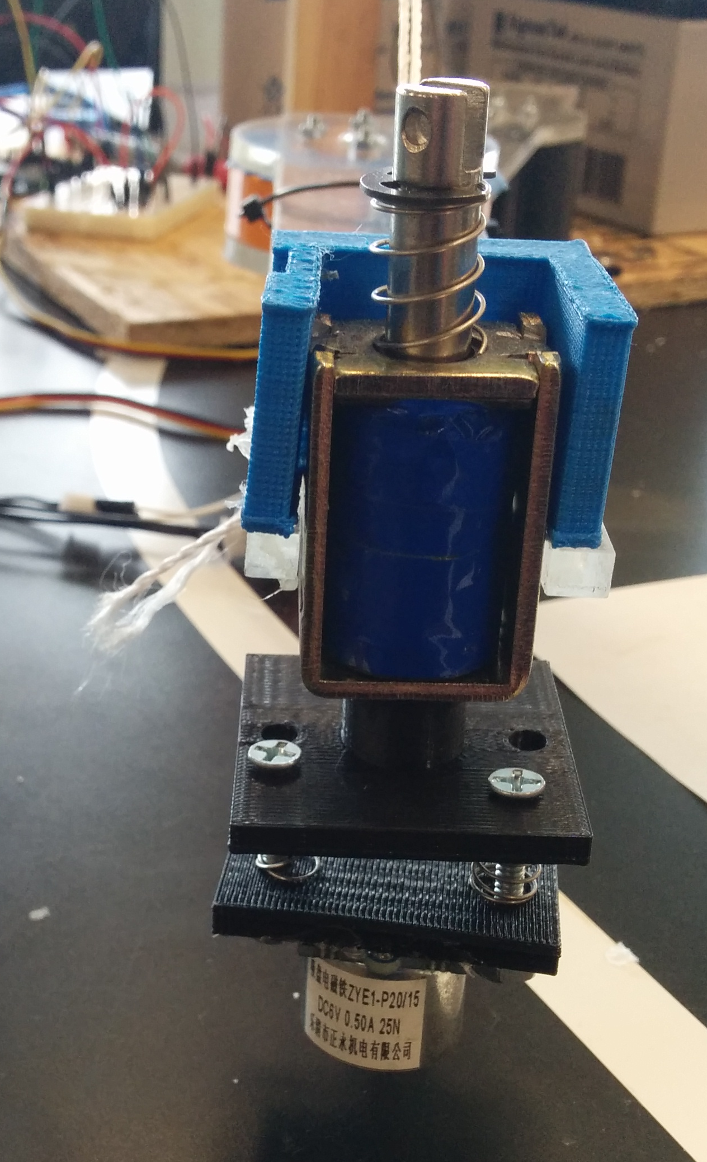
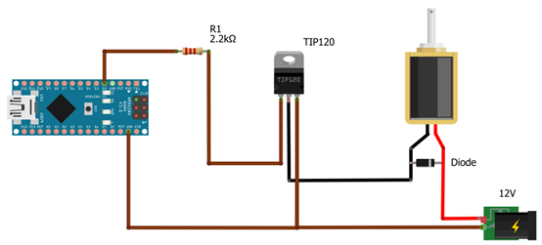
Mechanical Design

Slide 13
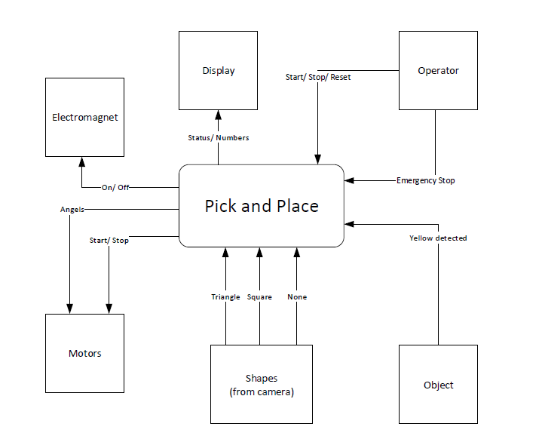
Software Design

Slide 14
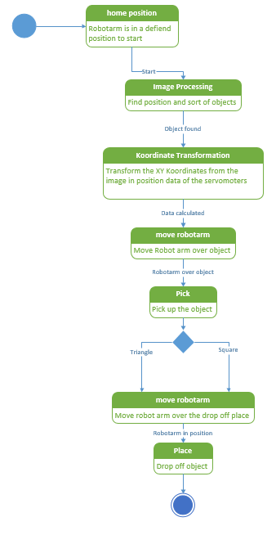
Software Design

Slide 15
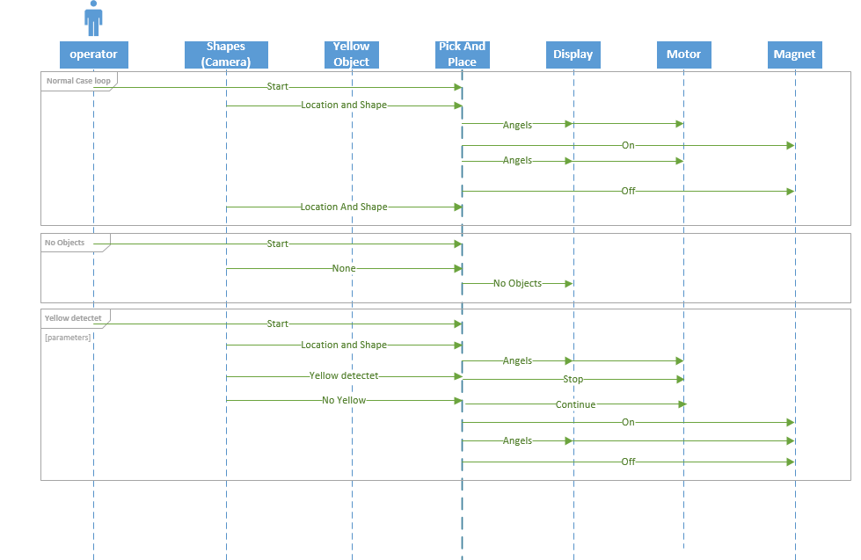
Software Design

Slide 16
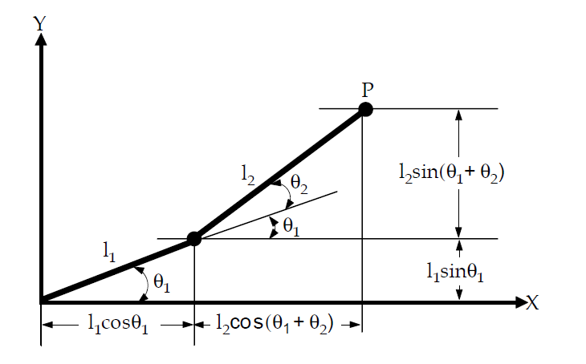
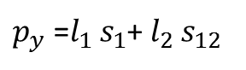
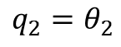
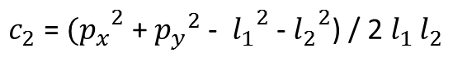
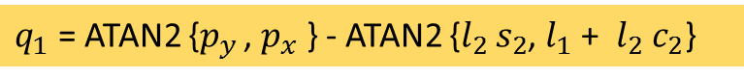
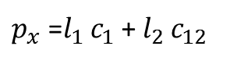
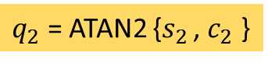
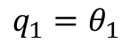
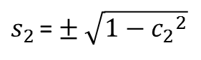
direct kinematics
$$q_{1}=θ_{1}$$
$p_{x}$ =$l_{1 }c_{1}$ + $l_{2 }c_{12}$
$$q_{2}=θ_{2}$$
$p_{y}$ =$l_{1 }s_{1}$+ $l_{2 }s_{12}$
squaring and summing the equations of the direct kinematics
${p_{x}}^{2}$ + ${p_{y}}^{2}$ - ( ${l_{1}}^{2}$+ ${l_{1}}^{2}$) = 2 $l_{1 }l_{2}$ ($c_{1 }c_{12 }$+ $s_{1 }s_{12}$ ) = 2 $l_{1 }l_{2}$ $c_{2}$
$c_{2}$ = ${{(p}_{x}}^{2}$ + ${p_{y}}^{2}$ - ${l_{1}}^{2}$ - ${l_{2}}^{2}$) / 2 $l_{1 }l_{2}$
$s_{2 }$=$±$ $\sqrt{1−{c_{2}}^{2}}$
$q_{2}$ = ATAN2 {$s_{2 }$, $c_{2}$ }
$q_{1}$ = ATAN2 {$p_{y }$, $p_{x}$ } - ATAN2 {$l_{2 }s_{2}$, $l_{1}$ + $l_{2}$ $c_{2}$}

Slide 17
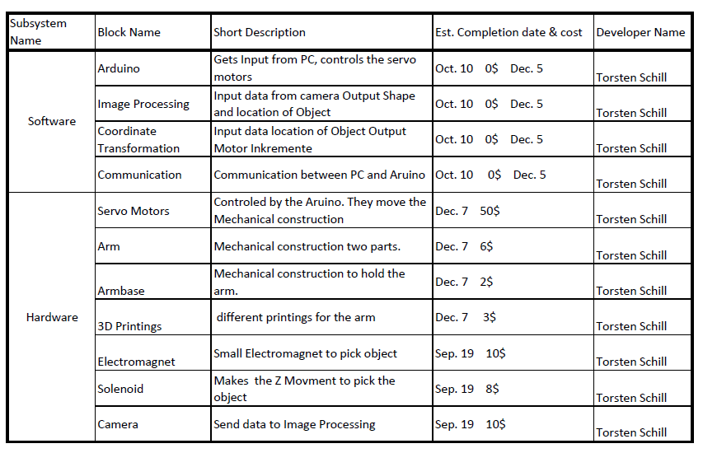
Budget

Slide 18
Summary

